Slide 1
Automated Coupling of Circuit and Chassis for Synthetic Biology
Napier car rolling chassis, c. 1912
Mac G4
chassis
Bryan Bartley Herbert Sauro and John Gennari
bbartley@u.washington.edu
COMBINE 2017
10/11/2017

Slide 2
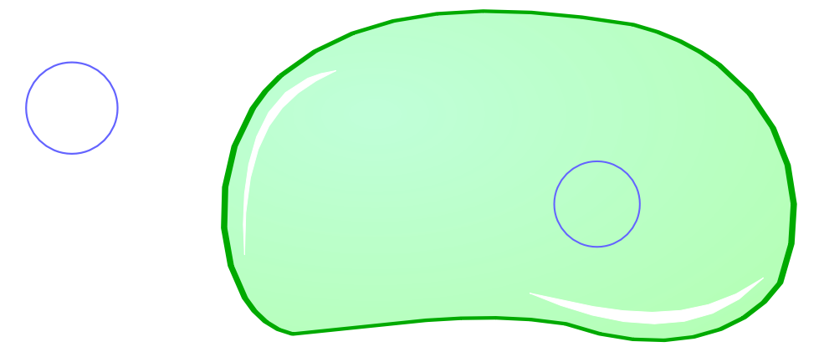
Engineering Analogies for Synthetic Biology
Circuit = DNA construct that encodes novel biological functions, usually a plasmid
Chassis = host organism
Modules, interchangeable components, standards, etc.

Slide 3
Many Factors Determine Chassis / Circuit Compatibility
Plasmid and host must have compatible origins of replication
Multi-plasmid systems must have compatible origins
Plasmid and host must not have the same selection marker
Different host strains are optimized for different processes, eg. DNA assembly, protein expression, screening
Although DNA is the universal language of life, organisms speak many different dialects. Foreign genes may not express well in the host.
These technical considerations are often confusing and difficult even for the experts. Let’s automate it!

Slide 4
Automated Coupling of Chassis and Circuits
UW
Host
Hub
Circuits Repository
Chassis Repository
Compatibility constraints may be defined as validation rules in libSBOL / pySBOL “extensions”

Slide 5
SBOL Extensions Add New Classes, Properties, and Validation Rules to the Data Model & Serialization
SBOL Extension
SBOL Core Data Model
Read & Write in SBOL File Format

Slide 6
pySBOL “Host” Extension
from sbol import *
def host_context_validation_rule_1(host):
# Validate that host and plasmid do not have the same selection marker
...
class Host(ComponentDefinition):
def __init__(self, uri = 'host', doc = None):
# Derive from SBOL core class
ComponentDefinition.__init__(self, SBOL_COMPONENT_DEFINITION, uri, 'http://purl.obolibrary.org/obo/GO_0005623', '1.0.0')
# Define extension properties
self.taxonomy = URIProperty(EXTENSION_NS + "taxonomy", self.this)
self.genotype = TextProperty(EXTENSION_NS + "genotype", self.this)
# Extend validation rules
self.components.addValidationRule(self, host_context_validation_rule_1)

Slide 7
Conversion of Host Organisms to SBOL
Scrape strain repositories and instantiate “Host” object
Convert host genotype to SBOL objects
Openwetware.org
SBOL
SBOL
w/
TaxonID
More
SBOL
Search NCBI taxonomy
and annotate Taxon ID

Slide 8
Representing Host Genotype as Structured SBOL
name: “DB3.1”
type: <GO: 0005623>
taxonId: “634468”
Host
roles: <SO: 0000001026>
Genome
DB3.1 Genotype
F- gyrA462 endA1 glnV44 Δ(sr1-recA) mcrB mrr hsdS20(r_{B}⁻, m_{B}⁻) ara14 galK2 lacY1 proA2 rpsL20(Sm^{r}) xyl5 Δleu mtl1
name: “SmR”
roles: <SO: 0005623>, <GO:0046679>
Mutation

Slide 9
Replication Origins and Selection Markers Determine Host / Plasmid Compatibility
“Ampicilin”
“ampicillin”
“AmpR”
“ampR”
“Apr”
“bla”

Slide 10
Conversion of Genbank Plasmid Maps to SBOL
Convert natural
language annotations
to ontology terms
Genbank to
SBOL conversion
Genbank
“Genbankish”
SBOL
Proper
SBOL
Host organism | Ontology term | Ontology ID
Origin of replication | origin_of_replication | SO:0000296
Selection marker | request pending
Ampicillin resistance | “beta-lactam antibiotic catabolic process” | GO: 0030655
Chloramphenicol resistance | “response to chloramphenicol” | GO: 1901322
Tetracycline resistance | “response to tetracycline” | GO: 1901326

Slide 11
Assembly of Chassis and Circuit
host.assemble([plasmid])

Slide 12
Assembly Fail
name: “DB3.1”
type: <GO: 0005623>
taxonId: “634468”
Host
Plasmid
roles: <SO: 0000001026>
roles: <SO: 0000001026>
Genome
name: “streptomycin resistance”
roles: <SO: 0005623>, <GO:0046679>
name: “SmR”
roles: <SO: 0005623>, <GO:0046679>
Mutation

Slide 13
Extension Data are Fully Exchangeable
ComponentDefinition
.h, .py
Host
<sbol:ComponentDefinitiont>
Java
SBOL
file
C++ / Python

Slide 14
Summary
We’re working on a SynBioHub repository specifically for host strains
Choosing a suitable host is a complicated decision which can be simplified and automated for the synthetic biologist
Current ontologies are workable but limited for supporting some of these use cases
SBOL is an “extensible” data standard
Extensions can be used to implement new classes and new validation rules for SBOL while remaining fully exchangeable

Slide 15
Acknowledgements
Michal Galdzicki
Arzeda Corp
Seattle, WA
John Gennari
UW BIME
Kiri Choi
UW Bioengineering
Herbert Sauro
UW Bioengineering
NSF #1355909

Slide 16
SBOL Integrates Data Across Networks
Every SBOL data object has a uniform resource identifier (URI).

Slide 17
1
Data exchange with libSBOL (C++) extensions
Host(ModuleDefinition)
.h
.h
Host(ModuleDefinition)
<host_context:Host>
C++
.sbol
C++/Java
Data exchange with generic annotations
2
Host(ModuleDefinition)
GenericTopLevel()
.h
<host_context:Host>
C++
.sbol
C++/Java

Slide 18
Some Example Extensions
Design-build-test
Extension
Host context
Extension
3D Structure
Extension

Slide 19
Need SO term for selection marker
Process
Bacteriostatic
response tochloramphenicol | Any process that results in a change in state or activity of a cell or an organism (in terms of movement secretion enzyme production gene expression etc.) as a result of a chloramphenicol stimulus. less | biological_process | GO
antibioticcatabolicprocess | The chemical reactions and pathways resulting in the breakdown of antibiotic a substance produced by or derived from certain fungi bacteria and other organisms that can destroy or inhibit the growth of other microorganisms. less | biological_process | GO

Slide 20
Enterobacteriaceae
Escherichia
Escherichia coli
Escherichia coli BL21
Escherichia coli BL21(DE3)
Escherichia coli K-12Escherichia coli BW25113
Escherichia coli MC1061
Escherichia coli str. K-12 substr. DH10B
Escherichia coli str. K-12 substr. MG1655
Escherichia coli MV1994
Escherichia coli MV2A6
Escherichia coli str. K-12 substr. MG1655star
synthetic Escherichia coli C321.deltaA
Escherichia coli str. K-12 substr. MG1656
Escherichia coli str. K-12 substr. W3110

Slide 21
Taxonomic Divergence
1
|
131567
|
2
/ \
1224 1783272
/ \
1236 1239
/ \
91347 91061
/ \
543 1385
/ \
561 186817
\
1386
\
653685
Bacteria
E. coli
B. subtilis

Slide 22
Taxonomic Divergence of Model Species
Host organism | DNA Source | Taxonomic Divergence
E. coli | E. coli (DH5alpha) | 2
E. coli | B. subtilis | 13
E. coli | M. extorquens | 11
E. coli | S. cerevesiae | 18
E. coli | H. sapiens | 36

Slide 23
Python Code is Generated from C++
Code generation
with SWIG
Compilation
Extra plumbing
libSBOL
(.cpp)
Wrapper code
(.cxx)
Python extension library (.so .dll)
pySBOL module
(.py)
LibSBOL can be translated into other languages implemented in C/C++ as well (eg Matlab)
Some consistency of the API across different languages
Serialization is well-validated and predictable (ideal for a standard language such as SBOL!)

Slide 24
setHomespace('http://sys-bio.org')
doc = Document('openwetware.xml')
doc.append('outfiles/BBa_J179000.xml')
doc.append('genbank_to_sbol.xml')
host = doc.componentDefinitions['BL21']
host = host.cast(Host)
plasmid = doc.componentDefinitions['http://sys-bio.org/public/igem/BBa_J179000/1']
enzyme_gene = doc.componentDefinitions['http://sys-bio.org/AJ629832/1']
plasmid.assemble([enzyme_gene])
host.assemble([plasmid])

